Slide 1
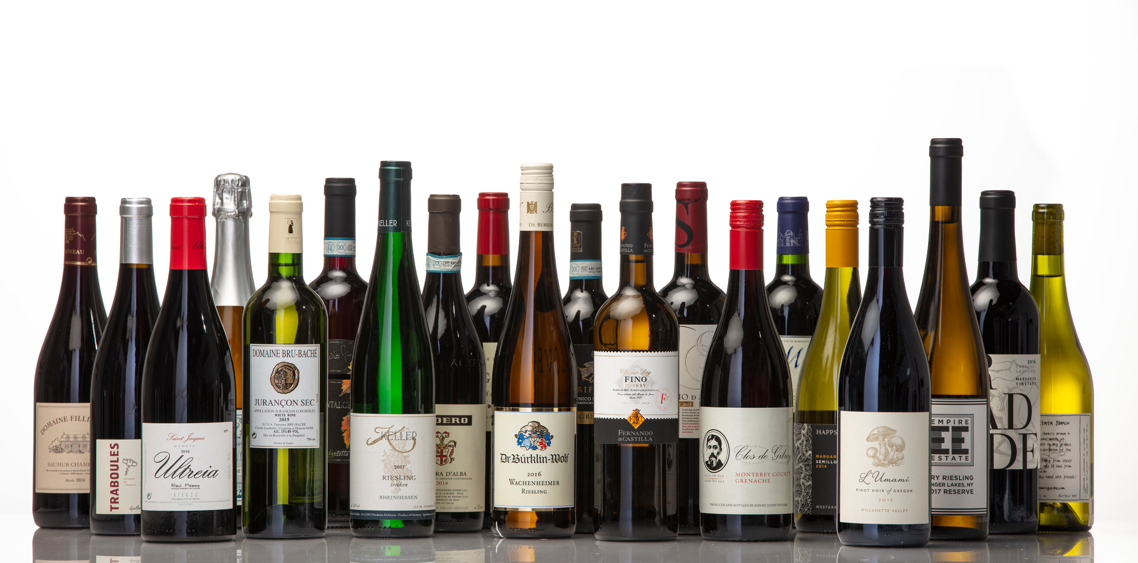
EDA on Wine quality dataset
Term1 & 2 Project
- Presenter – Dhiraj Ambure (April 2020 batch)

Slide 2

Agenda
Problem Statement
Understanding Dataset
Pandas Profiling: Pre-Processing
Data Processing
Pandas Profiling: Post-Processing
EDA
Conclusions
Thank You

Slide 3
Problem Statement
It is very difficult to assess the quality of wine just by reading the label. Quality is assessed best by tasting. But as we have dataset which contains different ingredient of wine and also we have Quality of Wine column. So based on that we will try to find out what should be level of various ingredients to get the best quality of wine.
Based on our analysis of the given data, we hope to come to a conclusion on levels of various ingredients to use in order to produce the best quality of wine

Slide 4
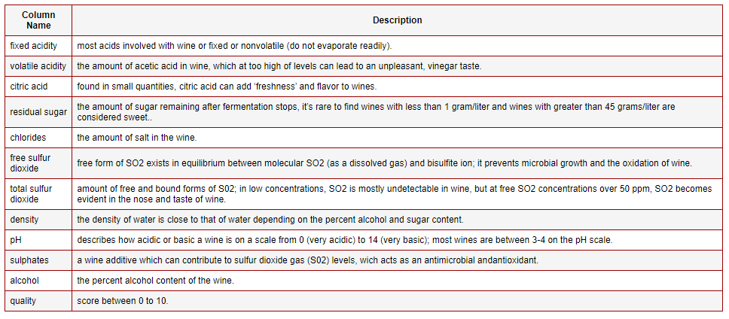
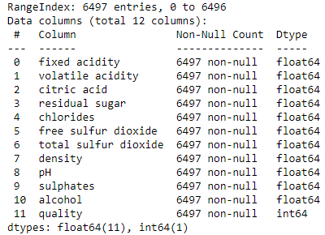
Understanding Dataset
There are total 6497 records (Rows) in 12 separate columns in original dataset
Out of 12, 11 columns indicate 11 different ingredients of Wine & 1 column indicates the quality of the wine
Out of 12, 1 Column is Integer and others are of float datatype
There seems to be no missing value in dataset
There is no categorical column in given dataset

Slide 5
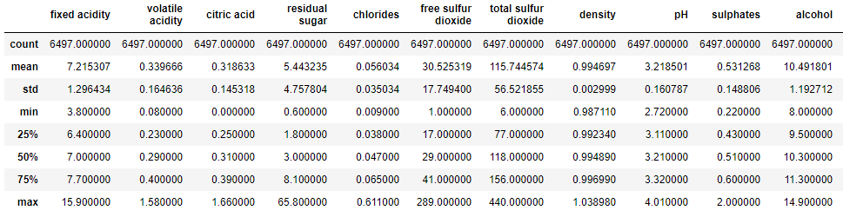
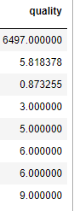
Understanding Dataset
fixed acidity, volatile acidity, residual sugar & chlorides*** data is positively (Right) skewed as it's mean value lies to the right of median(50%) value
citric acid, free sulfur dioxide, total sulfar dioxide, density, pH & alcohol data seems to be normally distributed because mean value is close to the median(50%) value
By comparing 75% value & max value, we can see that most of the columns have outliers

Slide 6
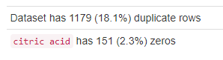
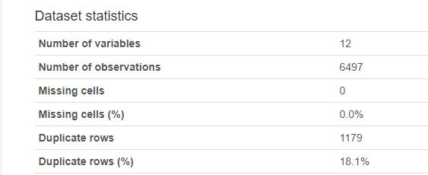
Pandas Profiling Before Data Processing
Profiling the data before we process data
There are 1179 duplicate records in given dataset
Citric Acid has 151 zeroes
Check data distribution for each column

Slide 7
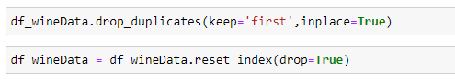


Data Processing
Delete Duplicates and reset indexes
Converting total sulfar dioxide & free sulfur dioxide to Integer
Changing volatile acidity, chlorides & alcohol to 2 decimal points & density to 4 decimal points
Delete Outliers
Calculate Z-Score for data in each column and store it in separate column
Take indexes from each Z-Score column where Z-Score >= 5
Create a set of all Indexes and drop all Z-Score
Delete the outliers using indexes – Total 69 records deleted

Slide 8
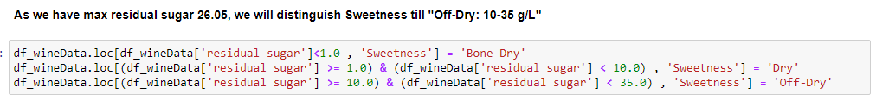

Data Processing
Basic Wine Characteristics
Sweetness
Bone Dry: < 1 g/L
Dry: 1-10 g/L
Off-Dry: 10-35 g/L
Sweet: 35-120 g/L
Very Sweet: 120-220 g/L
Acidity
pH is the measure of acidity in wine on
a logarithmic scale (Mostlt between 2.5 and 4.5)
pH and acidity have a negative correlation
Tannin
More the Tannins, Dryer the Wine
Body
Light-Bodied: 8-10% Alcohol
Medium-Bodied: 10-12% Alcohol
Full-Bodied: 12-15% Alcohol

Slide 9
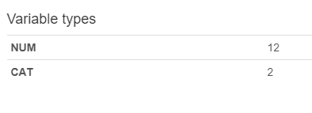
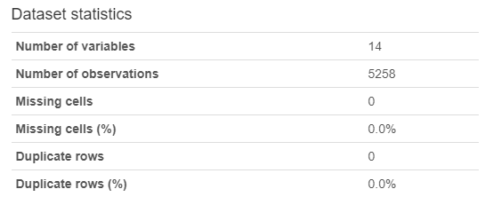
Pandas Profiling: Post-Processing
After deleting duplicate records and Outliers
Also created 2 categorical columns ‘Sweetness’ & ‘Body’

Slide 10
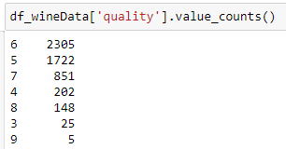
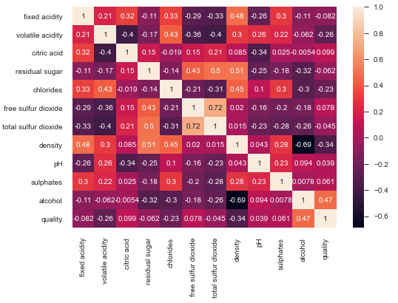
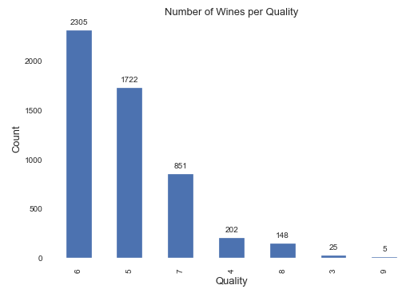
EDA
Ingredients correlating with ‘Quality’
Alcohol (+ve Correlation)
Density (-ve Correlation)
Chlorides (-ve Correlation)
Volatile Acidity (-ve Correlation)

Slide 11
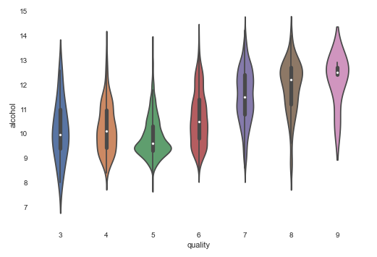
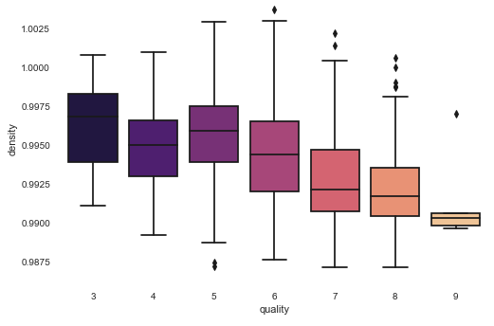
EDA
Quality v/s Alcohol
Higher alcohol %, Better Quality
Quality v/s Density
Lower density, better quality

Slide 12
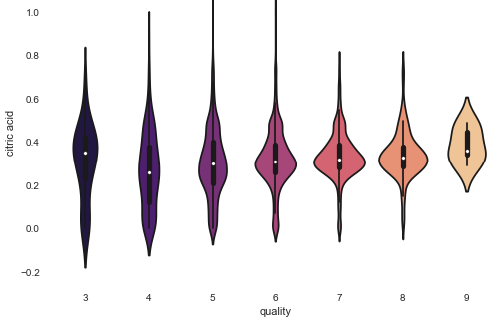
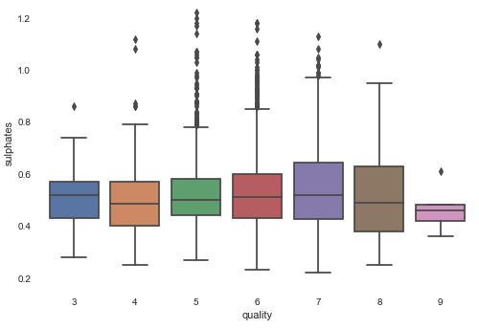
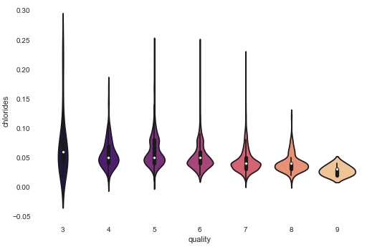
EDA
Quality v/s
Citric Acid – On higher side for High quality wines
Sulphates – On lower side for High quality wines
Chlorides – Salt in the wine is on lower side for High quality

Slide 13
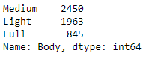
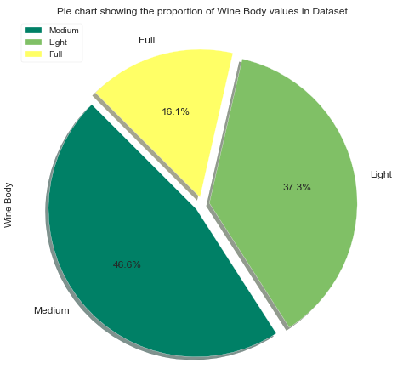
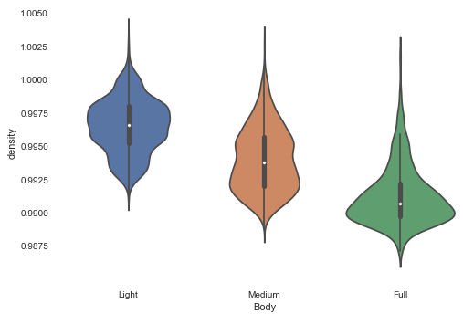
EDA
We will check behaviour of various ingredients v/s Alcohol Body
Alcohol Body v/s Density
Density decreases with increase in Alcohol %

Slide 14
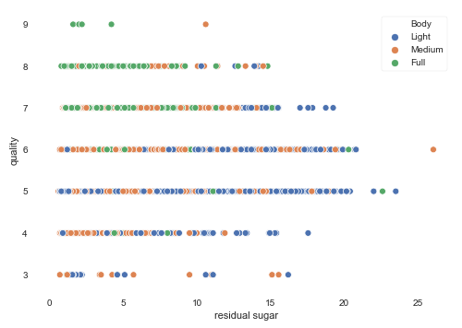
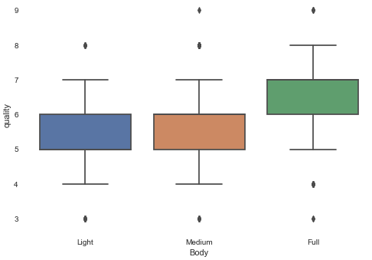
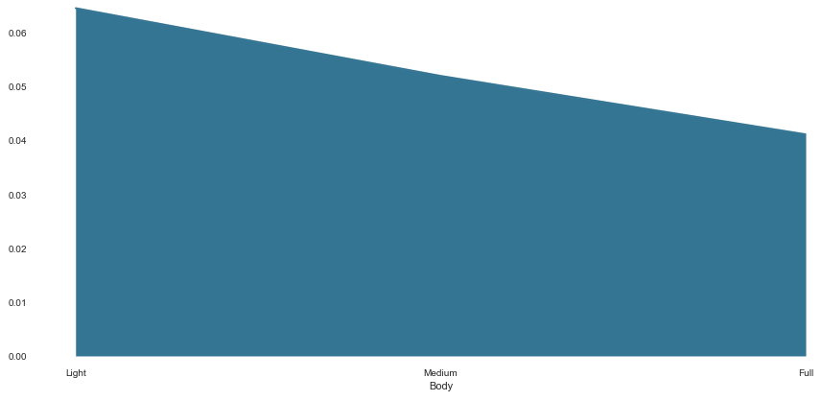
EDA
Alcohol Body v/s Quality
In High quality wines, alcohol % is more
Medium Alcohol % doesn’t seem to be increasing the quality (Multiple types of wines?)
Wines with low alcohol % have higher residual sugar, quality is medium
High alcohol % wines have low residual sugar and quality is high
Higher % Alcohol body wines have lower Chloride (Salt levels)

Slide 15
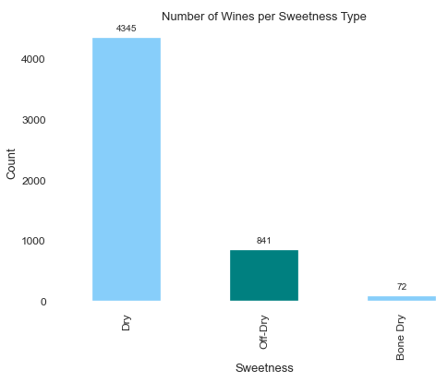
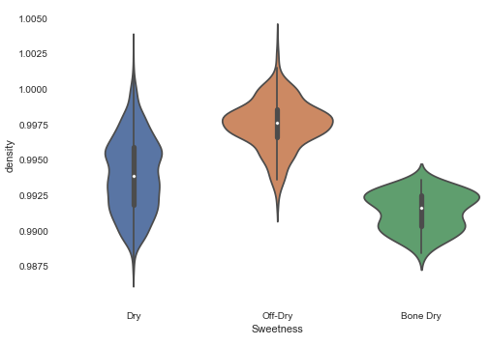
EDA
Count
Bone Dry (< 1g/L) – 72
Dry (1-10 g/L) – 4345
Off-Dry (10-35 g/L) - 841
Wine Sweetness v/s
Density
With increase in sweetness, Density also increases

Slide 16
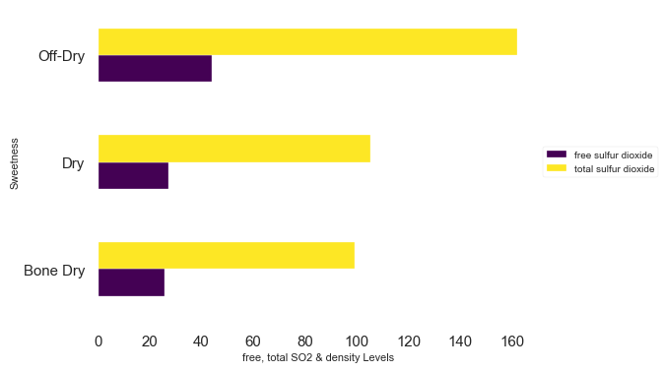
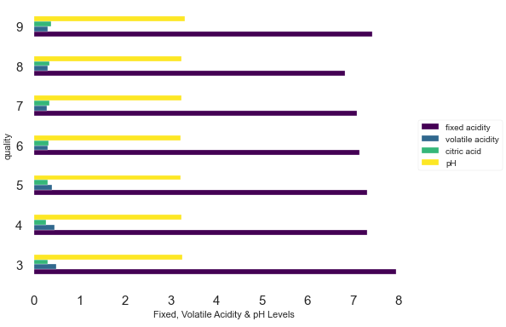
EDA
Sweetness v/s Free & Total SO2
With increase in sweetness, Total & Free SO2 also increases
Acidity (fixed acidity, volatile acidity, citric acid, pH)
Low quality wines have high levels of fixed & volatile acidity & low citric acid
In high quality wines, fixed & volatile acidity is low and citric acid is more
If Fixe acidity increases, then to maintain high quality, residual sugar also increase
pH of wine depends on wine type (white/red/sparkling, etc. This type of data is missing in dataset)

Slide 17
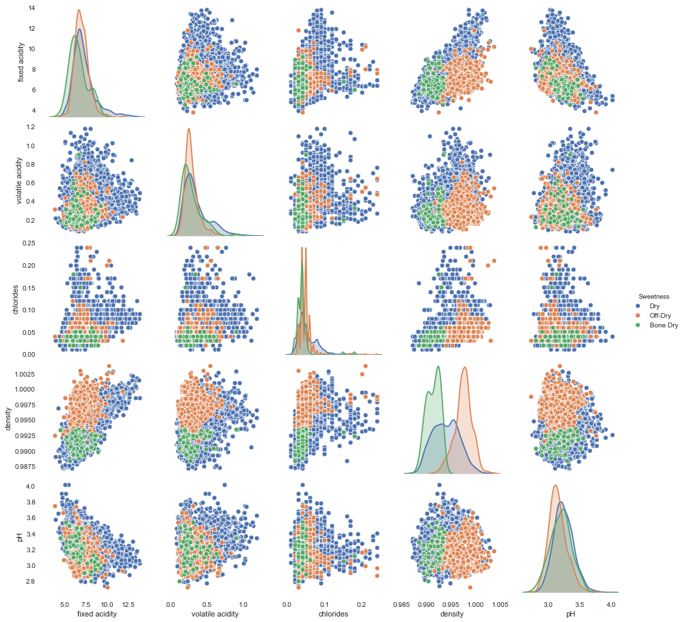
EDA
Sweetness v/s
fixed acidity
volatile acidity
Chlorides
Density
pH
Upon further analysis, we can see that correlation between most of the ingredients ‘V-Shaped’, which indicates there are at least 2 types of wines (Red/White/Sparkling) in given data.
As each type of wine will have different levels of ingredients

Slide 18
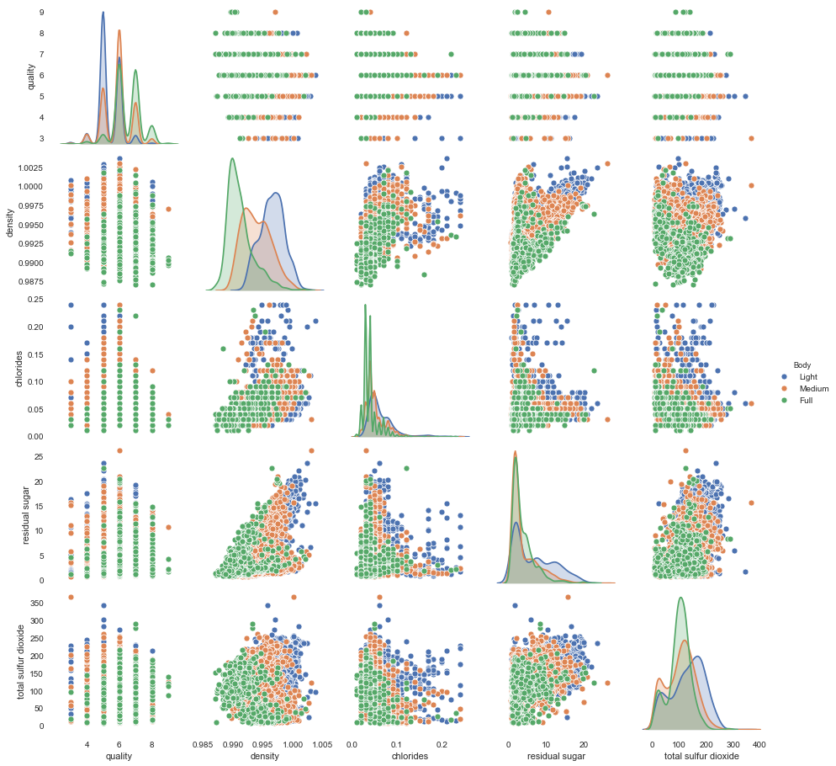
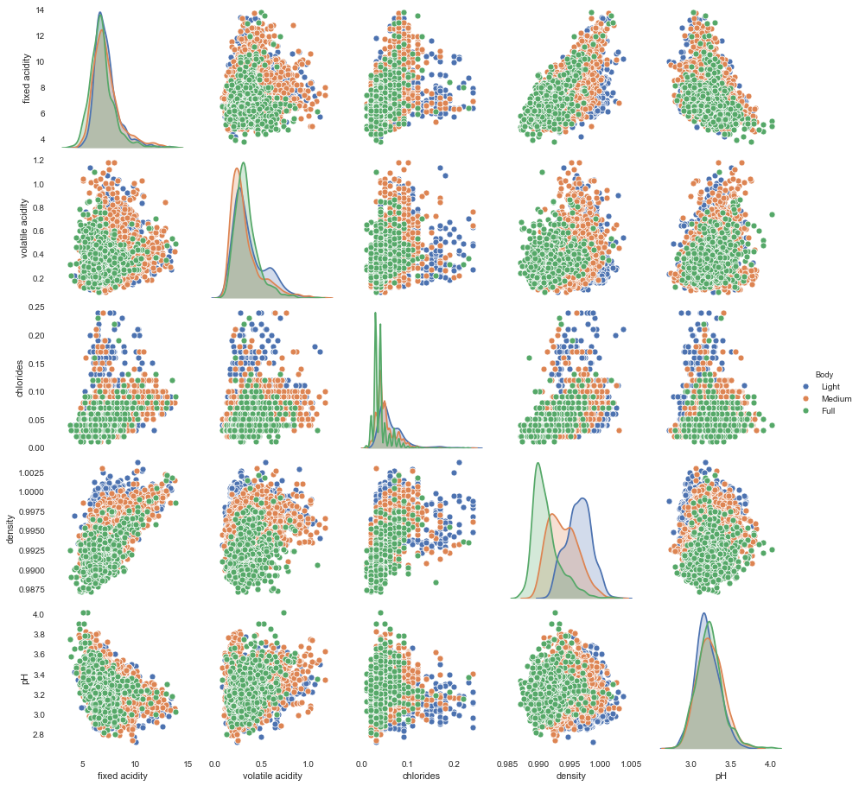
EDA
Plotting hue= Alcohol Body against quality, density, chlorides, residual sugar and total sulfur dioxide
Hue = Alcohol Body against fixed acidity, volatile acidity, chlorides, density and total pH

Slide 19
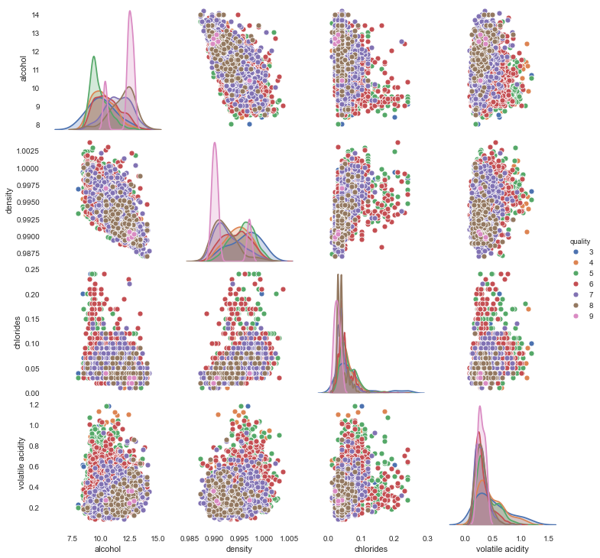
EDA
Hue = quality, against alcohol, density, chlorides and volatile acidity
These all graphs confirm our theory of multiple wine types in given dataset

Slide 20
Conclusion
Types of Wines are missing in current dataset, Red, White, Sparkling etc.
As the level of ingredients differ in these wine types
Wine colour depends on acids in wine and types of grapes
Types of grapes if given, would be added advantage
From the analysis of data in given dataset, we can say
Best Wine has (in most cases)
Higher Alcohol - 12-15%
Lower Density – 0.99
Acidity Level – (3.2-3.4 pH) – Increase in acidity is negated with increase in residual sugar to maintain the quality
Lower salt levels – (approx. 0.05)
Rest of the ingredients show ‘V-shaped’ correlation indicating multiple wine types
Can not clearly arrive to the conclusion on levels of these ingredients to get best wine

Slide 21

Thank You!!!!!!!!

